Slide 1
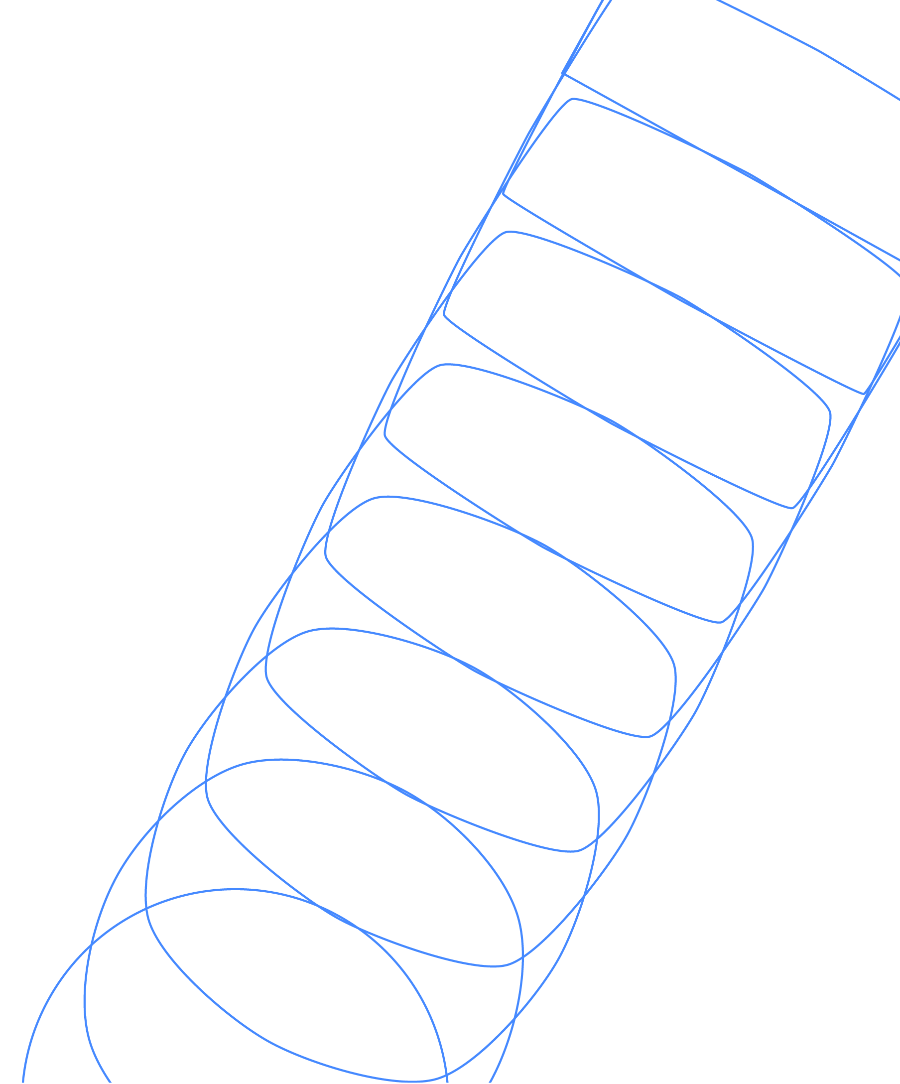
Introduction to Quantum Error Correction
James R. Wootton
IBM Quantum

Slide 2
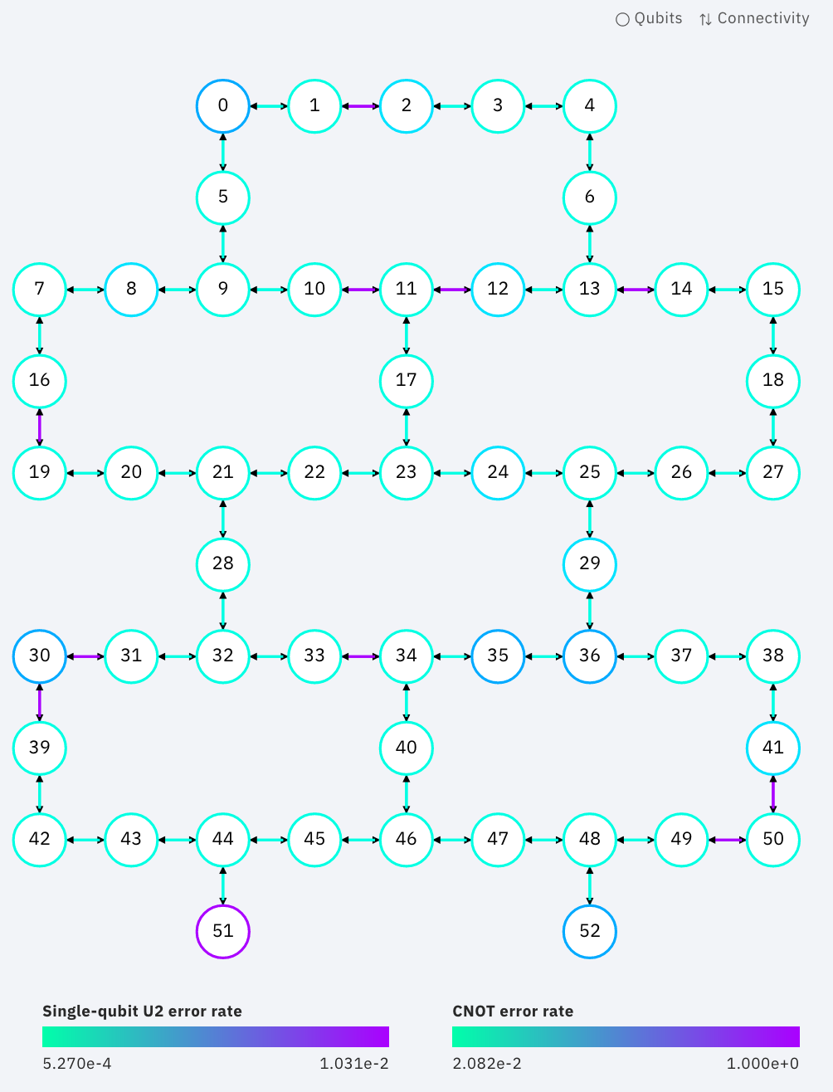
Why do we need QEC?
Superconducting qubits don’t work exactly the way they should
Each gate is slightly wrong
Qubits get poked by (small) external forces
Measurements sometimes lie
The same is true for spin qubits, topological qubits, photonic qubits, …
Any qubit made out of a real-life physical system will be at least a little bit rubbish

Slide 3
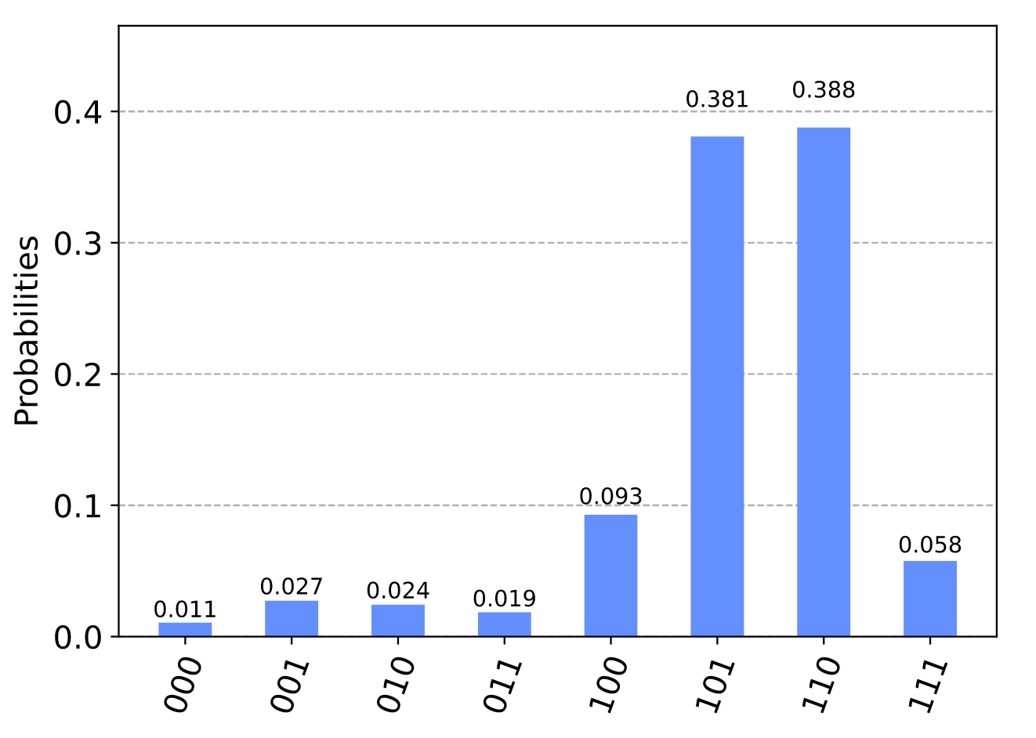
Why do we need QEC?
Algorithms like Shor, Grover, etc assume that qubits are perfect
Run them with imperfect physical qubits, and you’ll get nonsense out
Instead we need qubits that are flawless incarnations of the idea of quantum information
Such ideal qubits are called logical qubits
We need to somehow make perfect logical qubits out of noisy physical qubits

Slide 4
Why do we need QEC?
QEC is how we do this!
Typically, many physical qubits are needed per logical qubit
Using QEC in algorithms is therefore a long-term goal
As are the algorithms that require it
In the near term, we’ll try to make do and mitigate

Slide 5
In these lectures
We’ll look at the ideas behind error correction (classical and quantum)
We’ll go through specific examples
Repetition code
Surface code
We’ll see the most important techniques
Syndrome measurements
Decoding
Logical operations

Slide 6
What is Error Correction?
Before we explain quantum error correction, we should think about the general idea
A simple example: you are talking on the phone, and need to answer a question with ‘yes’ or ‘no’.
Two important things to consider:
How likely is it that you will be misheard? p = probability that ‘no’ sounds like ‘yes’, etc
How much do you care about being misunderstood? P_{a} = maximum acceptable error probability

Slide 7
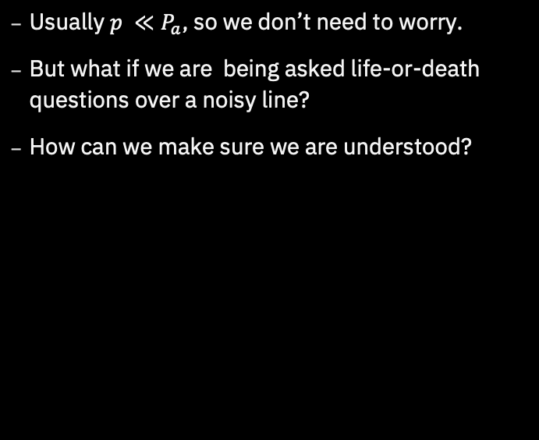
What is Error Correction?
Usually $p ≪P_{a}$, so we don’t need to worry.
But what if we are being asked life-or-death questions over a noisy line?
How can we make sure we are understood?

Slide 8
The Repetition Code
We could repeat ourselves.
With a lot of ‘no’s, it’s obvious we mean ‘no’.
Same for mostly ‘no’s with a few random ‘yes’s thrown in.
With this encoding of our message, it has become tolerant to small faults

Slide 9
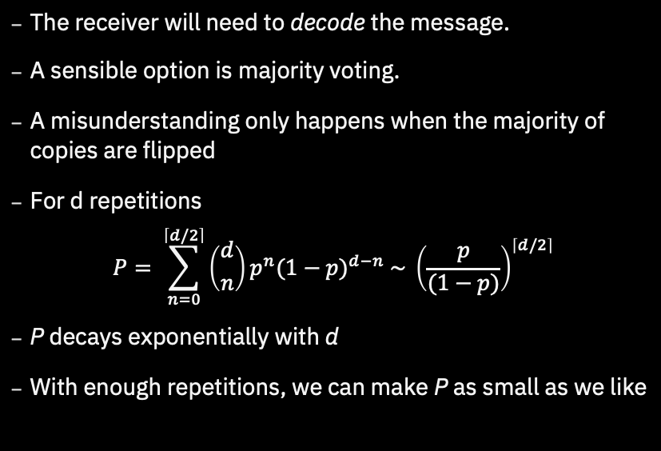
The Repetition Code
The receiver will need to decode the message.
A sensible option is majority voting.
A misunderstanding only happens when the majority of copies are flipped
For d repetitions
$$P= \sum_{n=0}^{\left\lceil d/2\right\rceil }{\left({d \atop n}\right)p^{n}{(1−p)}^{d−n} \sim {\left(\frac{p}{(1−p)}\right)}^{\left\lceil d/2\right\rceil }}$$
P decays exponentially with d
With enough repetitions, we can make P as small as we like

Slide 10
Encoding and Decoding
This example contained all the basic features of any protocol for quantum error correction.
Input: Some information to protect.
Encoding: Transform the information to make it easier to protect.
Errors: Random perturbations of the encoded message.
Decoding: Trying to deduce the input from the perturbed message

Slide 11
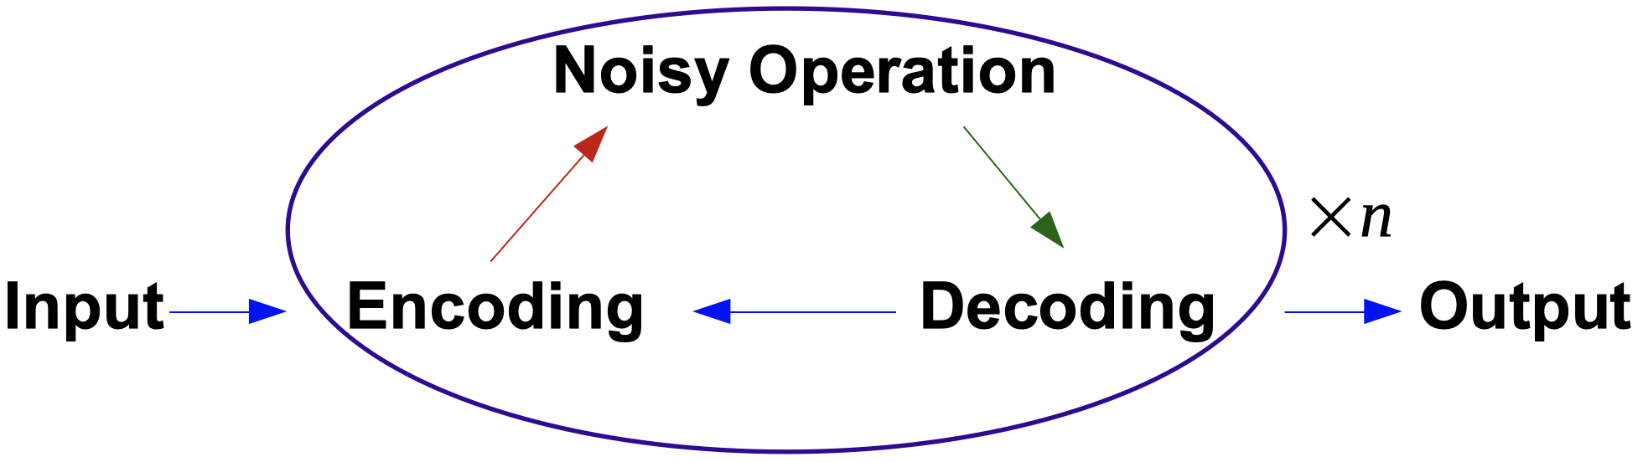
Computation
The example we just considered was one of communication, with errors occurring during transmission.
For computation, errors are introduced whenever we perform an operation.
We need to correct errors as they are introduced.
Can be done by constantly decoding and re-encoding

Slide 12
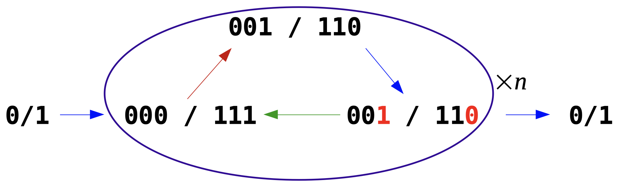
Computation
For example, here’s a single bit using the Repetition code
The ‘noisy operation’ here is just doing nothing (with some errors)
Here we don’t completely decode and re-encode, but just do it enough to find and fix the errors.

Slide 13
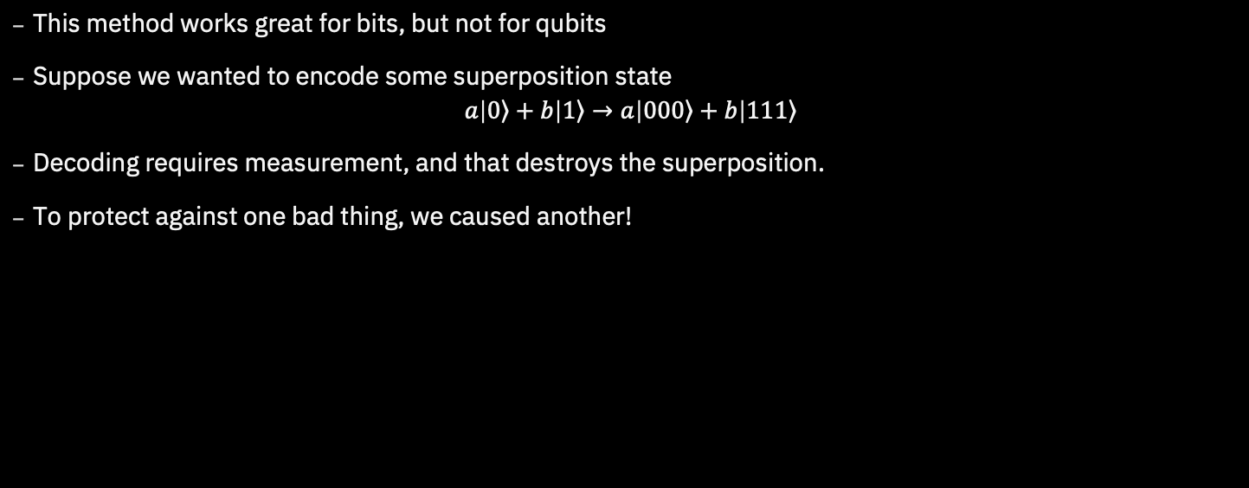
Quantum Computation
This method works great for bits, but not for qubits
Suppose we wanted to encode some superposition state $a\left|\left.0\right\rangle +b\right|\left.1\right\rangle →a\left|\left.000\right\rangle +b\right|\left.111\right\rangle$
Decoding requires measurement, and that destroys the superposition.
To protect against one bad thing, we caused another!

Slide 14
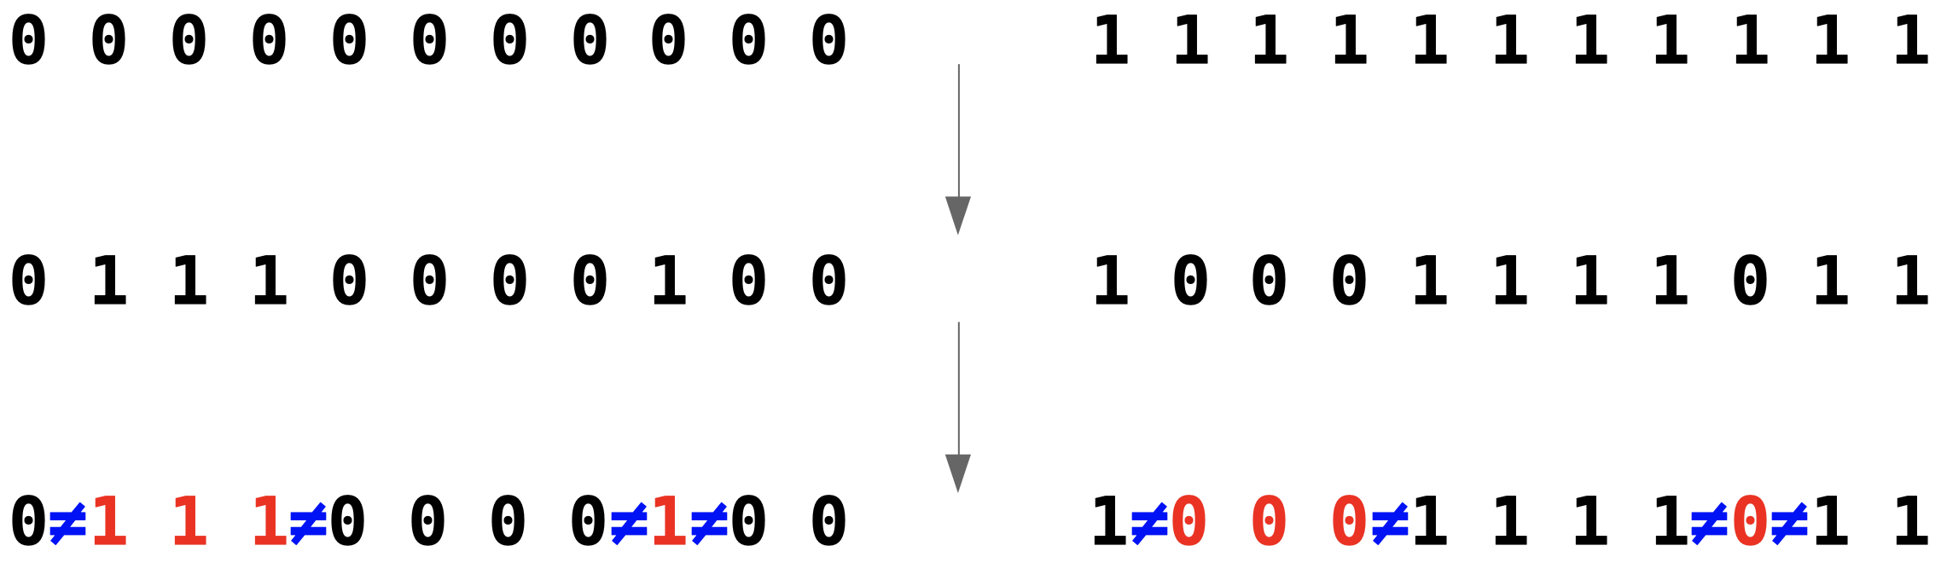
Quantum Computation
To solve this, we need to be more careful with our measurements.
We do need to measure, to get information about errors. But we must avoid learning about the encoded information
For this, note that we don’t actually need the bit values. We only need to know which ones have a different value to the rest.

Slide 15
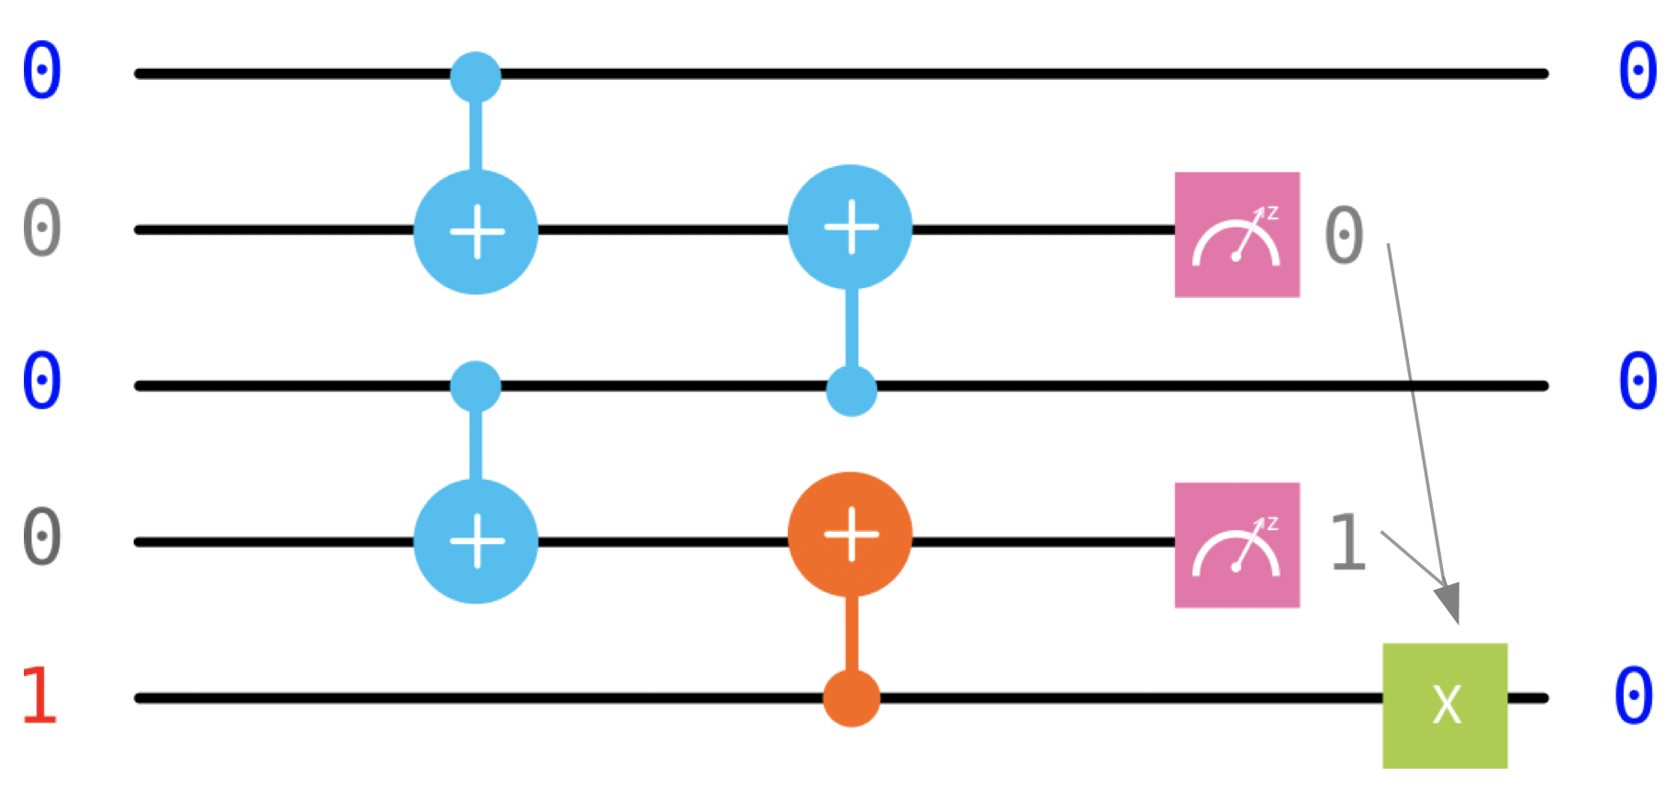
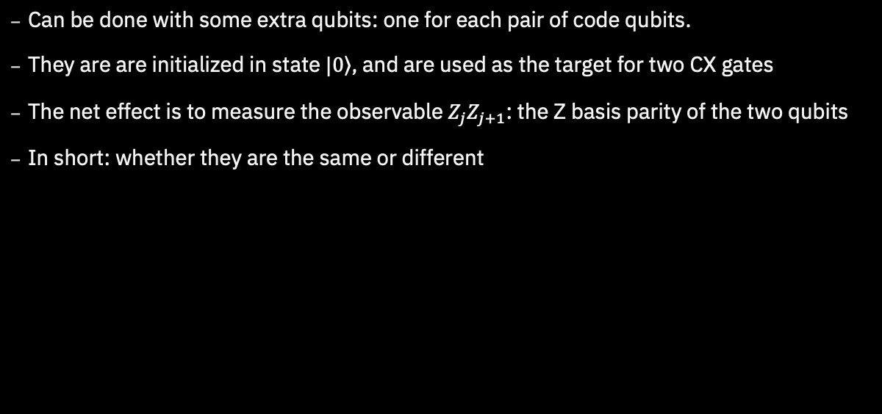
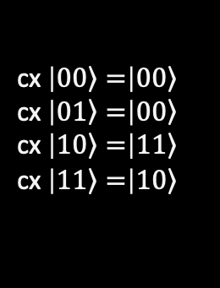
Quantum Repetition Code
Can be done with some extra qubits: one for each pair of code qubits.
They are are initialized in state $\left.|0\right\rangle$, and are used as the target for two CX gates
The net effect is to measure the observable $Z_{j}Z_{j+1}$: the Z basis parity of the two qubits
In short: whether they are the same or different
cx $\left|\left.00\right\rangle =\right|\left.00\right\rangle$
cx $\left|\left.01\right\rangle =\right|\left.00\right\rangle$
cx $\left|\left.10\right\rangle =\right|\left.11\right\rangle$
cx $\left|\left.11\right\rangle =\right|\left.10\right\rangle$

Slide 16
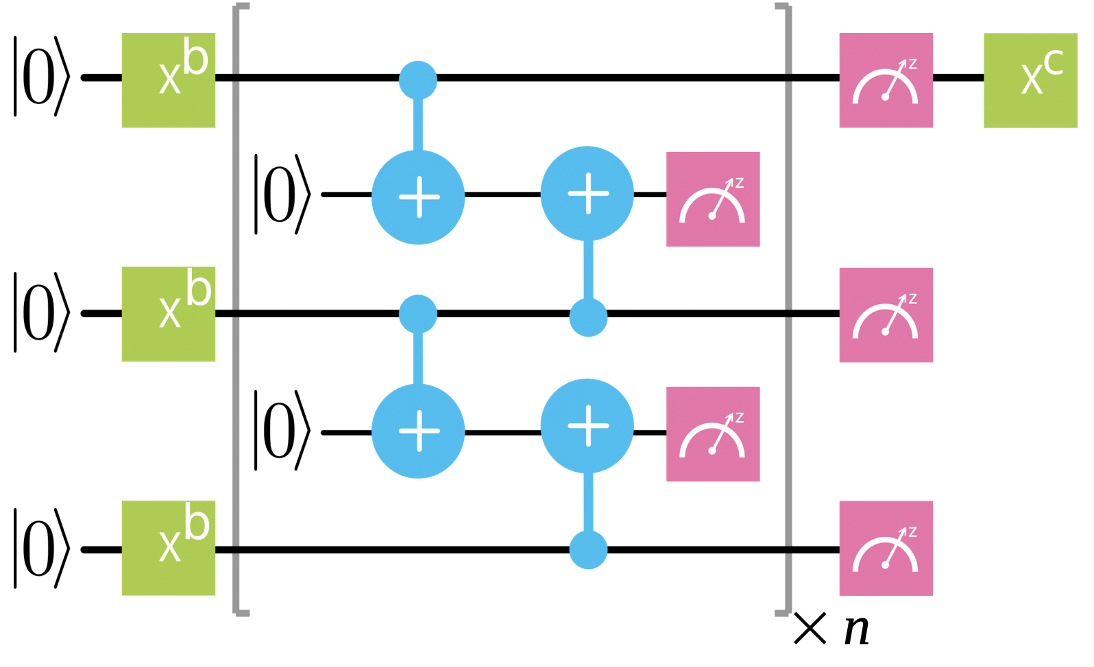
Quantum Repetition Code
The parity measurements are repeated over the course of the computation
The results are used to identify where errors likely occurred and how to remove their effects
This is done by means of a classical algorithm: a decoding algorithm
With this we can protect against bit flip errors for an arbitrarily long time

Slide 17
Syndrome Measurement
This measurement is a syndrome measurement
The result is known as the syndrome
All codes have them
They are ways to check that all the qubits are doing what they should be
Their form changes from code to code, but their job is always the same
They provide the clues that allow us to detect and correct errors

Slide 18
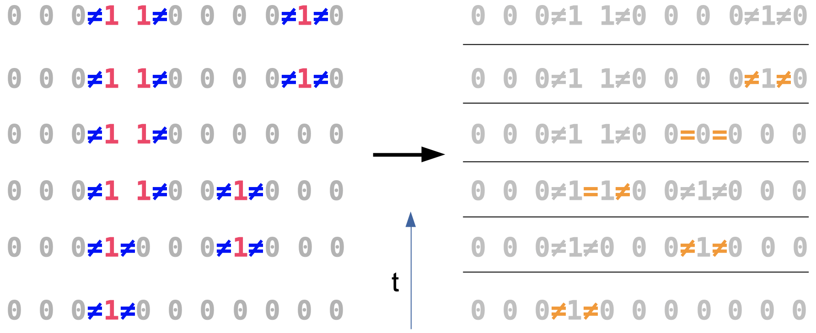
Decoding
Start with an unrealistically simple case: errors between parity measurements only (not during)
Focus on identifying errors for now (not correcting)
Look for changes between rounds
Errors create pairs of ‘defects’. Majority voting can be used to find a minimal pairing.

Slide 19
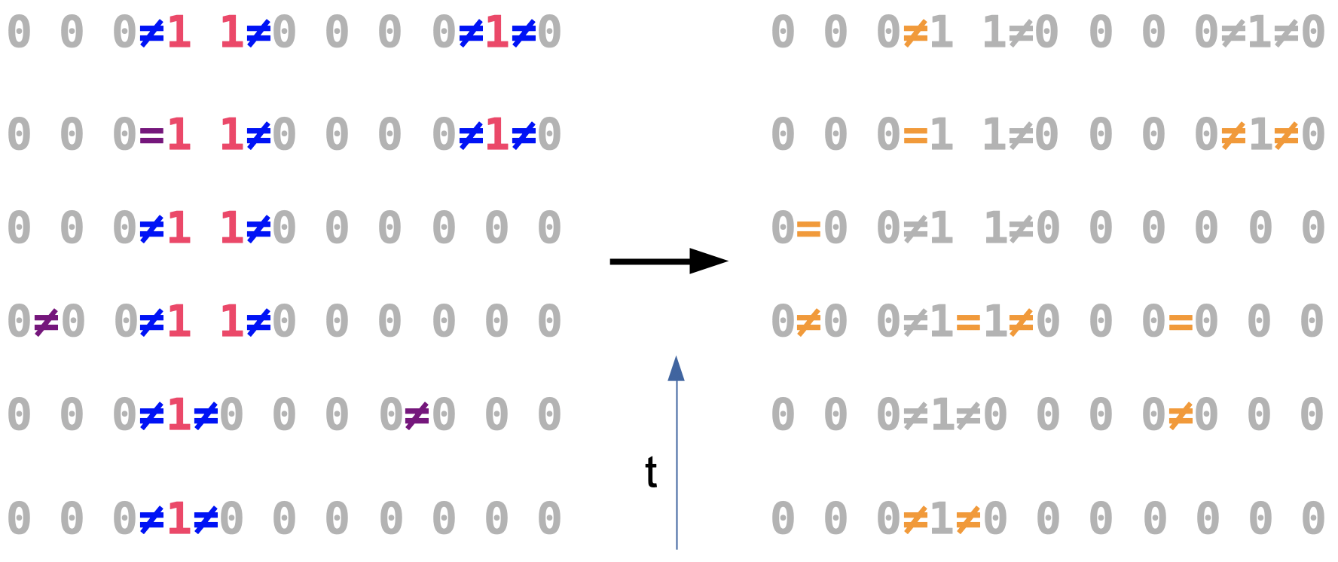
Decoding
Next, a simple model of noise in the measurements: they randomly lie
Again, look for changes between rounds
Bit flips create defects with space-like separation, measurement errors with time-like
Pairing is now a 2D problem, majority voting won’t work

Slide 20
Decoding
There are many ways to do this, all with pros and cons
One of the best is to think of the problem as a graph
Defects are nodes
The number of errors required to link them are weighted edges
A likely set of errors corresponds to the ‘minimum weight perfect matching’ of the graph
Efficiently computable using the ‘Blossom’ algorithm

Slide 21
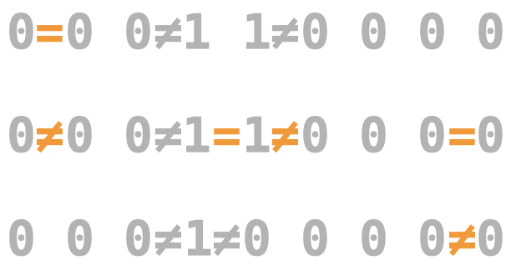
Decoding
Here it is in action for a portion of the example from earlier

Slide 22
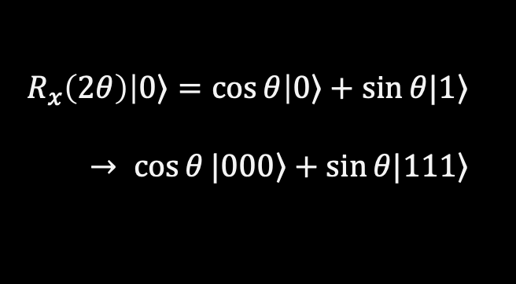
Logical Operations
If we wanted to manipulate the logical qubit, how could we do it?
This requires a logical operation, made up of many physical operations
The logical X gate is easy for the repetition code
Do physical X gates on code qubits
Code corrects imperfections
An Rx gate essentially needs you to take the code apart and put it back together again
Not protected while unencoded
$$R_{x}\left(2θ\right)\left|\left.0\right\rangle =\cos{θ}\right|\left.0\right\rangle +\sin{θ|\left.1\right\rangle }$$
$→ \cos{θ}|\left.000\right\rangle +\sin{θ|\left.111\right\rangle }$

Slide 23
Quantum Repetition Code
The limited set of fault-tolerant logical gates is a major problem with the repetition code
But it is not the only one!
The code only allows us to detect and correct bit fips, and only bit flips
Though we made sure that it doesn’t cause superpositions to collapse, it doesn’t protect them either
The repetition code is a good first example of quantum error correction, but it cannot give us fault-tolerant quantum computation

Slide 24
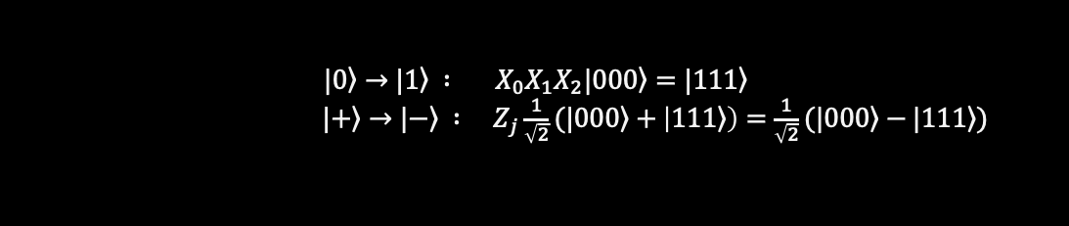
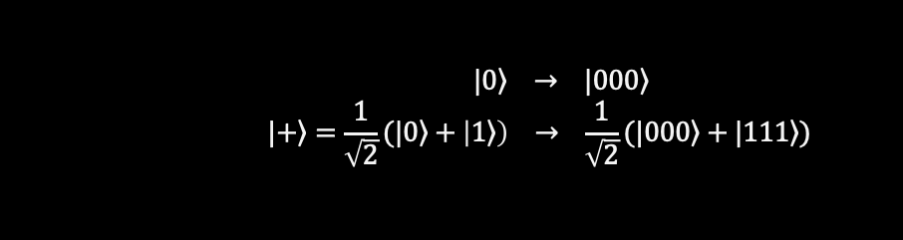
Towards a good quantum code
The problem with the repetition code is that it treats z basis states very different to x and y basis states
Example 1: z basis states are product states, the others are entangled
Example 2: Distinguishing encoded z basis requires a single qubit measurement, distinguishing x basis states requires d
Example 3: Flipping between z basis states requires d gates, but the x basis only takes one
It is not good when things are too easy, because they are easy for errors too!
$$|\left.0\right\rangle → |\left.000\right\rangle$$
$$|\left.+\right\rangle =\frac{1}{\sqrt{2}}(|\left.0\right\rangle +\left|\left.1\right\rangle \right) → \frac{1}{\sqrt{2}}(|\left.000\right\rangle +|\left.111\right\rangle )$$
$${|\left.0\right\rangle →|\left.1\right\rangle : X}_{0}X_{1}X_{2}|\left.000\right\rangle =|\left.111\right\rangle$$
${|\left.+\right\rangle →|\left.−\right\rangle : Z}_{j}\frac{1}{\sqrt{2}}(|\left.000\right\rangle +\left|\left.111\right\rangle \right)=\frac{1}{\sqrt{2}}(|\left.000\right\rangle −|\left.111\right\rangle )$

Slide 25
How good is QEC today?
We need to at least test the standard methodology
Encode bit values
Detect errors using stabilizer measurements
Correct during decoding
Simplest way is using the repetition code
Needs at least 5 qubits
Very flexible on connectivity
Detects and corrects bit flips

Slide 26
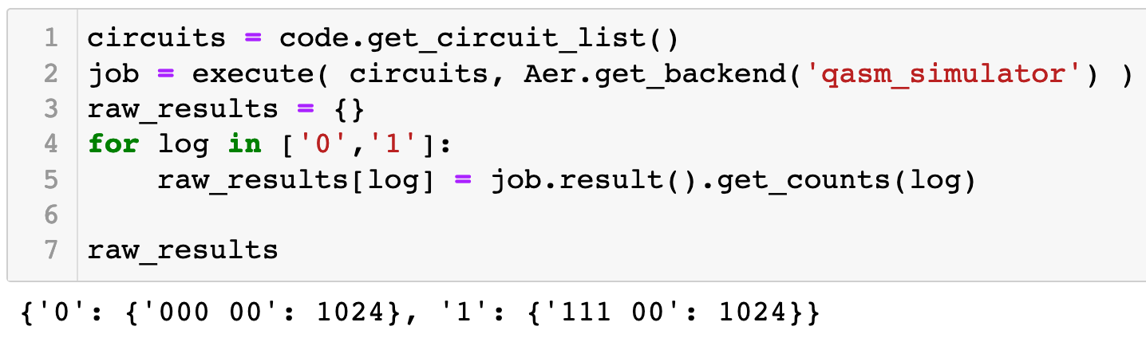
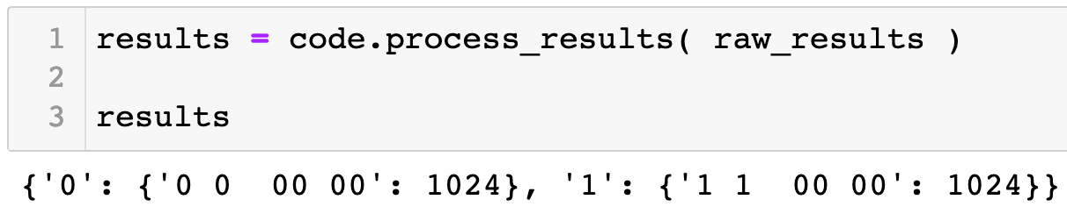
topological_codes in Qiskit Ignis
Two circuits per code that need to be run
Required output is the counts dictionary
The bit strings are transformed into a more QEC friendly form

Slide 27
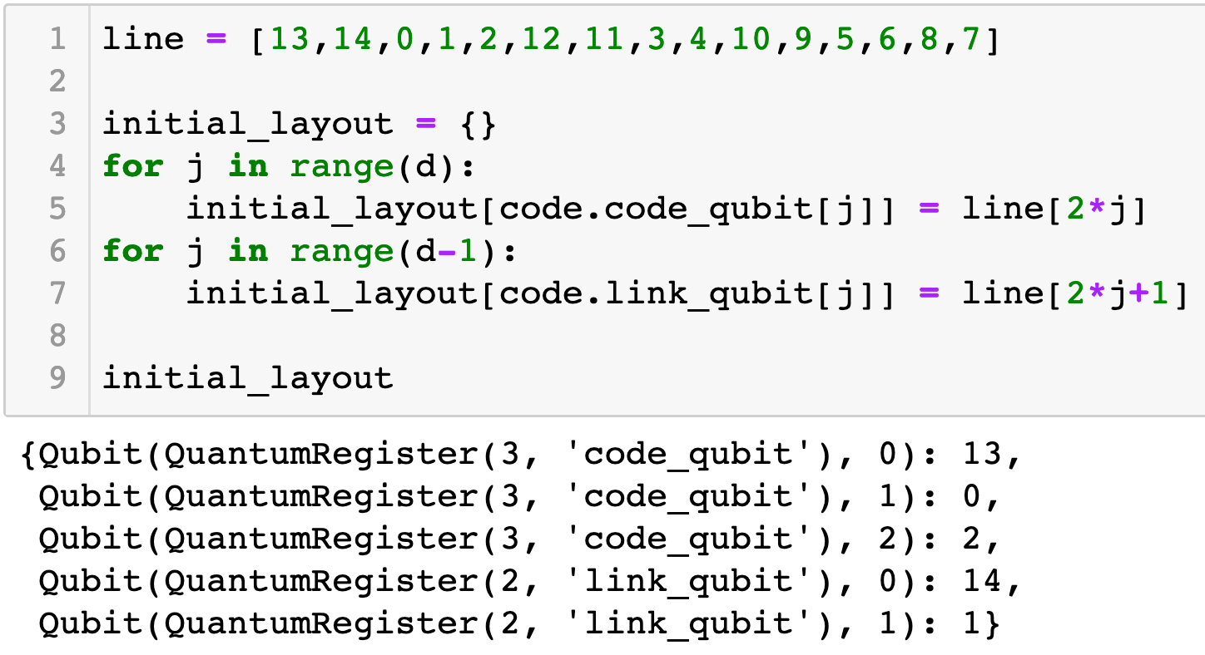
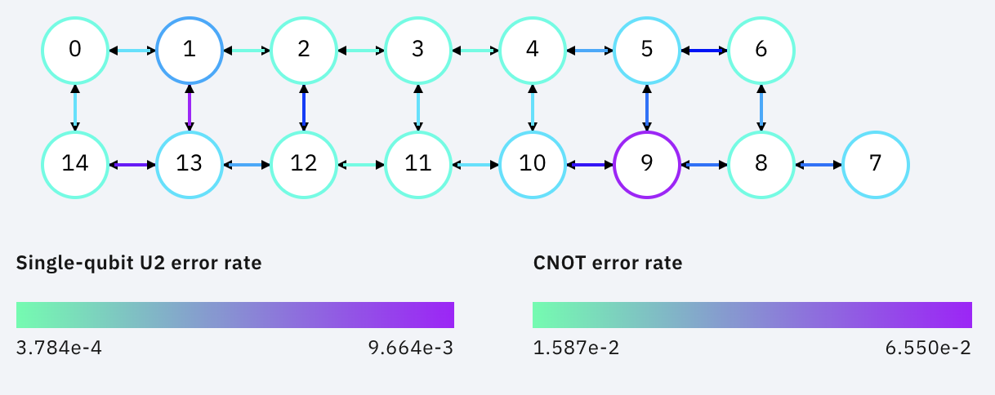
topological_codes in Qiskit Ignis
Important to know which qubits are being used
Remapping also remaps noise, making uncorrectable errors

Slide 28
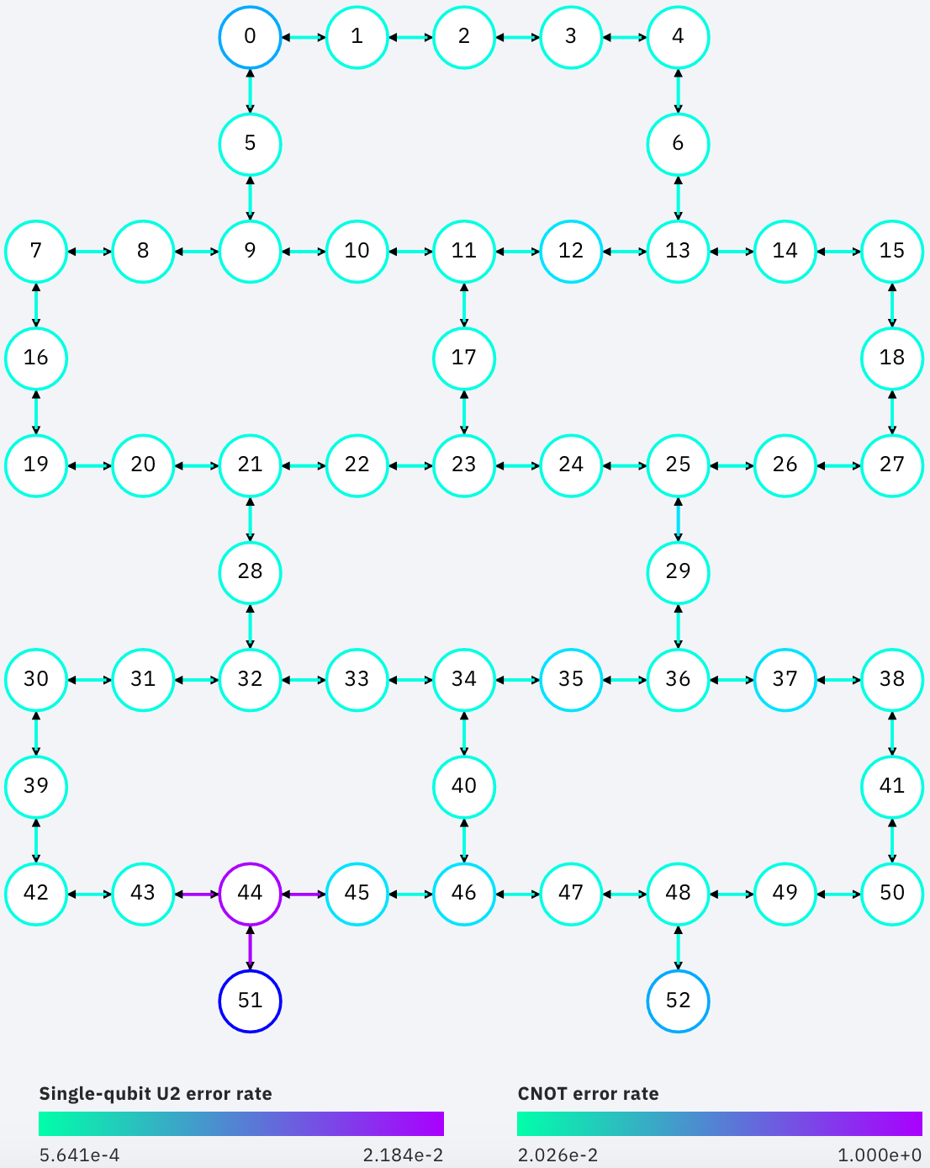
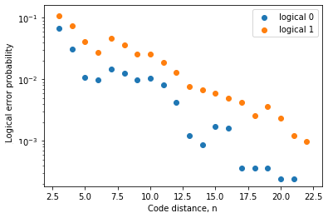
43 qubit results
James R. Wootton 2020 Quantum Sci. Technol. doi.org/10.1088/2058-9565/aba038
Run on rochester for d=3 to d=23 codes (up to 43 qubits)
Results consistent with exponential decay

